Slide 1
Minor Project (IT897)
Hierarchical Document-Tree Construction for Structure-Aware Retrieval-Augmented Generation
BY
Mr. KSHITIJ KHEDE (252IT010)
Department of Information Technology
National Institute of Technology Karnataka, Surathkal-575025
Under the Guidance of
Prof. ANANTHANARAYANA V. S.

Slide 2
Table of Contents
Introduction
Literature Survey
Problem Statement and Objectives
Methodology Used in this Work
Architecture
Results and Analysis
Discussion
Conclusion and Future Work
References

Slide 3
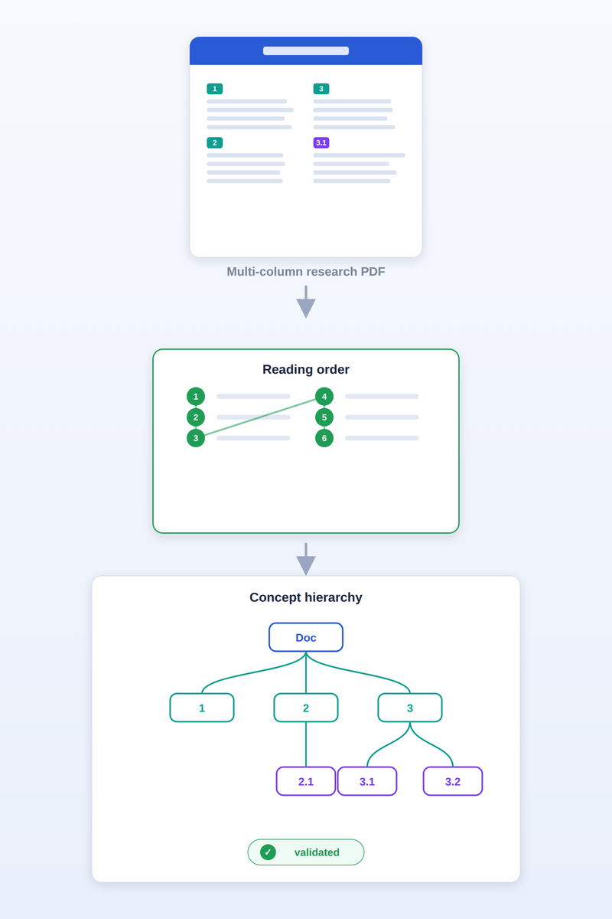
Introduction
Retrieval-Augmented Generation (RAG) lets an LLM answer using external documents instead of only its training data.
The quality of a RAG answer depends heavily on how the source document is represented before retrieval.
Research papers and technical PDFs are highly structured: multi-column layouts, numbered sections, and a title → section → subsection hierarchy.
Standard RAG pipelines flatten a PDF into fixed-size chunks, which destroys this structure:
  multi-column pages are read in the wrong order (text jumps across columns),
  the parent–child relationship between sections is lost.
This work (minor project) builds a layout-aware, hierarchical, validated document representation — the foundation on which reliable retrieval can later be built.
Fig.1. Structured document to a validated concept hierarchy

Slide 4
Literature Survey
Literature Survey — Structure-Aware Retrieval
Retrieval-Augmented Generation (RAG) improves an LLM's answers by retrieving relevant content from external documents at query time.
The quality of a RAG answer depends heavily on how a document is represented and chunked before retrieval — poor chunking loses information and breaks the links between related parts.
Early RAG systems split a document into flat, fixed-size passages, which discards its natural structure and reading order.
Recent research therefore moves toward hierarchical, structure-aware representations of documents.
Three works are most closely related to this project, each building document hierarchy differently:
  RAPTOR — a tree built by recursive semantic clustering + summarisation
  TreeRAG — tree-chunking that stores and retrieves along the document's hierarchy
  HiChunk — multi-level chunking using fine-tuned LLMs, with a dedicated benchmark

Slide 5
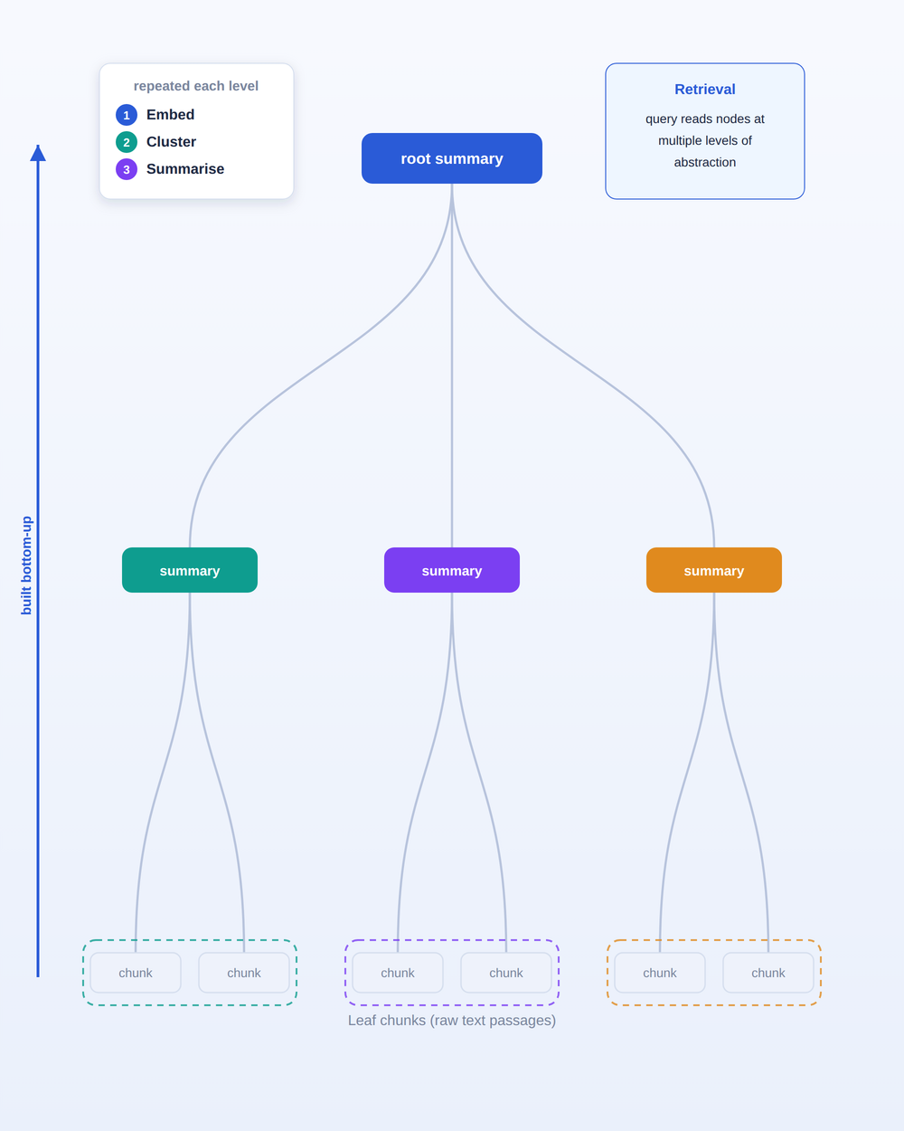
Literature Survey Contd.
RAPTOR — Recursive Tree-Organized Retrieval
Problem: standard RAG retrieves only short contiguous chunks, limiting holistic understanding of a long document.
Core idea: recursively embed → cluster → summarise chunks, building a tree bottom-up with levels of summarisation.
At query time, retrieves from this tree, combining information at multiple levels of abstraction.
Result: significant gains on multi-step QA (e.g. +20% absolute on the QuALITY benchmark with GPT-4).
Open issue: the tree is built from semantic similarity (clustering) — it does not use the document's own layout or native section hierarchy.
Fig.2. RAPTOR's recursive tree-building process

Slide 6
Literature Survey Contd.
TreeRAG — Hierarchical Storage for Long Documents
Problem: naive chunking destroys chunk integrity and breaks connections between related chunks, hurting Query-Focused Summarisation.
Core idea: Tree-Chunking — chunk and embed content in a tree-like structure that preserves the document's hierarchy.
Retrieval: Bidirectional Traversal — "root-to-leaves" and "leaf-to-roots" — to keep related chunks connected and reduce noise.
Evaluated on Finance, Law and Medical subsets; improves recall, quality and precision.
Open issue: relies on the tree structure but does not address multi-column reading-order recovery or formal validation of the built tree.

Slide 7
Literature Survey Contd.
HiChunk — Hierarchical Chunking
Problem: document chunking lacks good evaluation; existing benchmarks miss chunking quality due to "evidence sparsity."
Core idea: multi-level (hierarchical) document structuring using fine-tuned LLMs, plus an Auto-Merge retrieval algorithm.
Introduces HiCBench, a benchmark with manually annotated multi-level chunking points.
Outcome of the Survey
Existing methods build hierarchy from semantics or learned models — the document's native layout and section numbering are underused.
Multi-column reading order is rarely recovered explicitly before structuring.
The induced hierarchy is not formally validated (no cycle / single-parent / depth guarantees).

Slide 8
Problem Statement and Objectives
Problem Statement:
Standard RAG breaks a document into flat, fixed-size chunks, which discard the document's structure and the relationships between its sections. This project builds a system that converts a PDF into a hierarchical tree — title, sections, subsections — so that retrieval can follow the document's real structure instead of flat chunks, and quantifies the structure this tree preserves relative to flat chunking.
Objectives:
Build a pipeline that converts a PDF into a hierarchical section tree (title → section → subsection).
Recover correct reading order on multi-column pages and classify headings from numbering and font size.
Induce a validated parent–child hierarchy (acyclic, single-parent, depth-bounded) with a confidence score per node.
Evaluate tree-construction accuracy against the document's own section numbering.
Compare the tree against flat fixed-size chunking and quantify the structure it preserves.
Provide a web interface to upload a PDF and inspect the recovered tree.

Slide 9
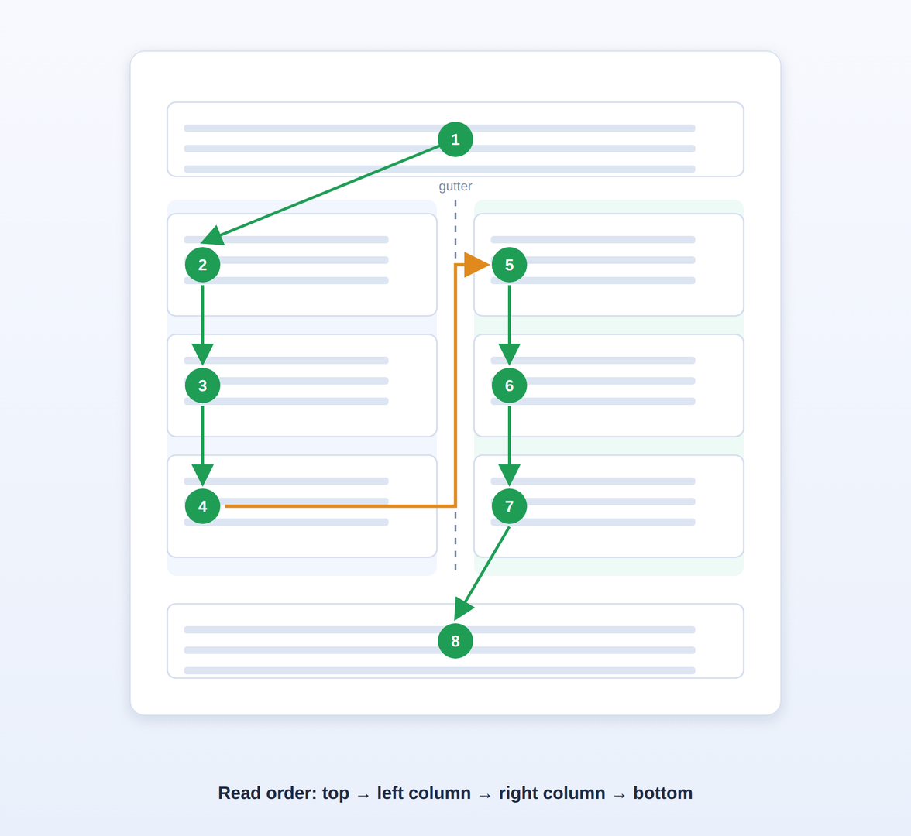
Methodology Used in this Work
Methodology — Column-Gutter Reading-Order Recovery
Problem: naive top-to-bottom sorting jumps between columns on multi-column pages.
Idea: detect the column gutter and read each column fully before moving on.
  Split the page at the vertical mid-line (gutter at page-width / 2).
  Classify each block: left column, right column, or spanning (width > 0.60 × page width).
  Place spanning blocks into top or bottom bands (title, full-width figures).
  Within a column, cluster blocks into lines using band tolerance τ_y = 20 pt, then order top-to-bottom.
Output order: top-spanning → left column → right column → bottom-spanning.
Fig.3. Column-gutter reading-order

Slide 10
Methodology Used in this Work Cond.
Methodology — Hierarchy, Validation and Confidence
Hierarchy induction (numbering-primary, semantic fallback):
  Primary signal: section numbering — "3.1" attaches to "3" (deterministic, exact).
  Fallback — Parent Ranking Engine (PRE) for unnumbered headings: Score(u,c) = 0.40·S_struct + 0.40·S_sem + 0.20·S_level
    S_struct = 1 / (1 + log(1 + |order(c) − order(u)|)); S_sem = TF-IDF cosine; S_level = max(0, 1 − 0.2·(Δlevel − 1))
Graph validation (before each edge is added):
  No cycles (upward-DFS), single parent per node, depth ≤ D_max = 8, document isolation → no orphans.
Confidence — KCE (topological propagation):
  C(v) = C_local(v) · (δ + (1 − δ)·C(parent)), with δ = 0.85; propagated in topological order (Kahn's algorithm).

Slide 11
Architecture
System Architecture
Dual-tier data model (validated schemas): Tier 1 = physical Text Blocks, Tier 2 = Concept Nodes.
Six modules, arranged as a pipeline:
  PDF Ingestion — extract text blocks with geometry + font (pdfplumber)
  Structural Parser — column-gutter reading order + heading classification
  Concept Extractor — headings → concept nodes, grounded to blocks
  Hierarchy Builder — numbering-primary attachment, PRE fallback
  Graph Validator — acyclic, single-parent, depth-bound checks
  KCE Scorer — topological confidence propagation
Data flow: PDF → blocks → ordered blocks → concepts → validated hierarchy → confidence-scored tree.

Slide 12
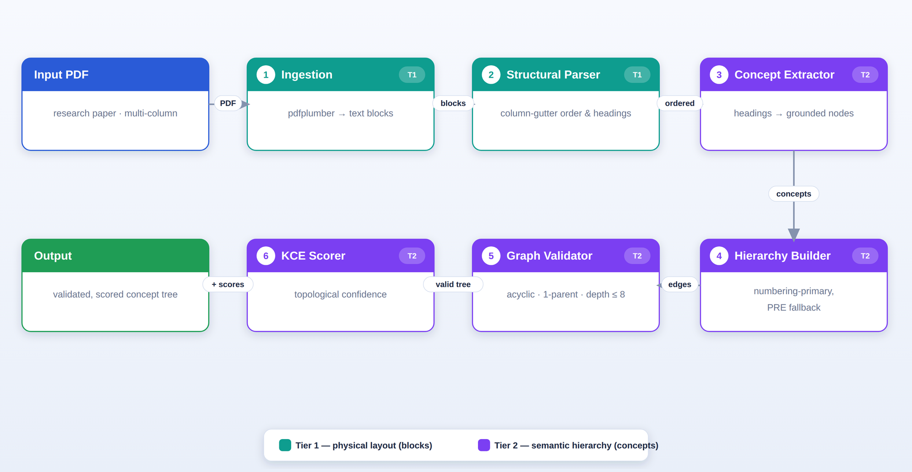
Architecture
Fig.4. Complete system architecture: a six-module pipeline over a dual-tier data model.

Slide 13
Results and Analysis
Results — Tree Construction
Evaluated on 11 research-paper PDFs; gold structure = each document's own section numbering.
Measure | Value
Structurally valid trees built | 11 / 11 (100%)
Mean nodes / parent–child links per doc | 22.2 / 21.2
Mean tree depth | 2.4
Parent-Assignment Accuracy (PAA) | 97.7%
Ancestor-Path Accuracy (APA) | 96.8%
Ancestor-Context Precision (ACP) | 97.3%
A valid tree is built for every document — acyclic, single-parent, depth ≤ 8, 0 orphans.
Near-perfect on 10 of 11 papers; the one weaker case (Self-RAG, PAA 78.9%) has irregular section numbering (stated as a limitation).

Slide 14
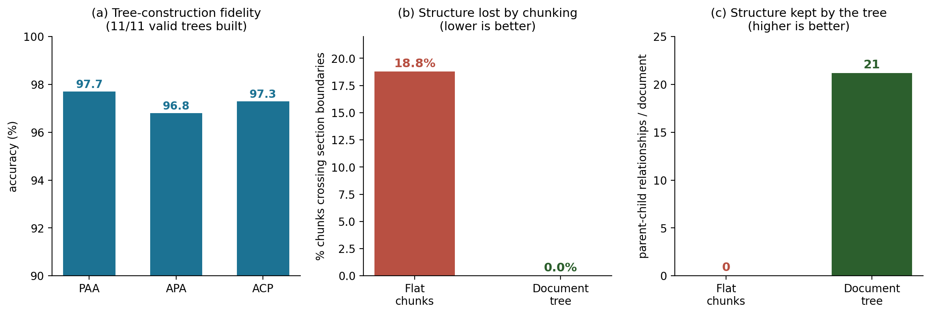
Results and Analysis Contd.
Results — Tree vs. Flat Chunking (same 11 documents)
Property (per document) | Flat chunking | Document tree
Units produced | 68.7 chunks | 22.2 nodes
Units crossing ≥ 2 sections | 18.8% | 0.0%
Parent–child links kept | 0 | 21.2
Chunk-size ablation (% chunks crossing sections):
Window | Straddle %
500 | 8.6%
800 | 13.0%
1000 | 15.9%
1200 | 18.8%
1500 | 22.9%
Tree (ours) | 0.0%
Flat chunking cuts across sections and keeps no parent–child links; the tree keeps every section intact and preserves all 21.2 links per document.

Slide 15
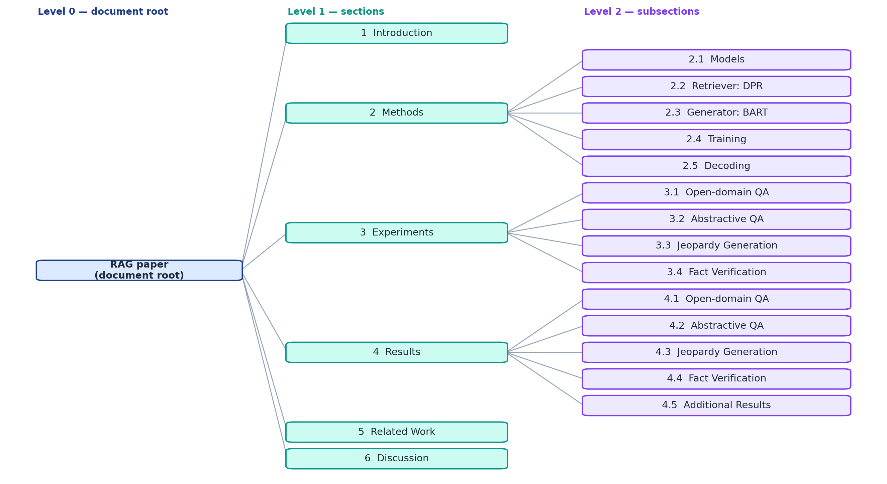
Results and Analysis Contd.
Contribution — Example Output: Recovered Document Tree (RAG paper, PAA = 100%)

Slide 16
Discussion
Tree, not chunks: flat fixed-size chunking cuts across sections (18.8% of chunks) and keeps 0 parent–child links; the document tree keeps every section intact (0%) and preserves all 21.2 links per document.
No chunk size closes the gap — flat straddling rises from 8.6% (500 chars) to 22.9% (1500 chars), while the tree stays at 0%.
Numbering is near-exact — a section number encodes its own parent (3.1 → 3); the PRE semantic fallback handles unnumbered headings.
Reading-order recovery (column-gutter) un-mixes multi-column pages before structuring, so downstream stages see the correct order.
Validation by construction — every edge checked before insertion: 0 cycles, 0 orphans, depth ≤ 8 across all 11 documents.
Lightweight — the six structural stages run in ~10.6 ms per document (excluding PDF parsing).
Limitation: accuracy is measured against numbering-derived gold (Self-RAG, with irregular numbering, is hardest).
Limitation: text-based PDFs only; the project builds and evaluates the tree but does not yet perform retrieval or answering.

Slide 17
Conclusion and Future Work
Conclusion:
Built a complete, training-free system that converts a PDF into a validated hierarchical document tree (the minor-project problem).
Builds a valid tree for all 11 papers; recovers the section hierarchy with 97.7% PAA, 96.8% APA, 97.3% ACP.
Direct comparison: the tree preserves structure flat chunking destroys — 0% section-straddling vs 18.8%, and 21.2 parent–child links kept vs 0.
Graph validation guarantees soundness — 0 cycles, 0 orphans, depth ≤ 8 across all 11 papers.
Delivered as a reproducible six-stage pipeline with a web demo.
Future Work:
Replace TF-IDF with a dense neural encoder (e.g. sentence embeddings) for stronger PRE.
Add cross-document linking to connect concepts across papers.
Build retrieval + answer generation on top of the validated hierarchy (full RAG).
Extend to scanned PDFs via OCR, and evaluate against human-annotated gold.
This minor project becomes one objective of the major project.

Slide 18
References
[1] P. Sarthi, S. Abdullah, A. Tuli, S. Khanna, A. Goldie, and C. D. Manning, "RAPTOR: Recursive Abstractive Processing for Tree-Organized Retrieval," in Proc. ICLR, 2024.
[2] W. Tao, X. Xing, Y. Chen, L. Huang, and X. Xu, "TreeRAG: Unleashing the Power of Hierarchical Storage for Enhanced Knowledge Retrieval in Long Documents," South China University of Technology.
[3] W. Lu, K. Chen, R. Qiao, and X. Sun, "HiChunk: Evaluating and Enhancing Retrieval-Augmented Generation with Hierarchical Chunking," Tencent Youtu Lab, 2025.
THANK YOU

